Slide 1
Report at the Group Meeting
Chaoyue Wang
Supervisor: Nana Liu
2020.5.1

Slide 2
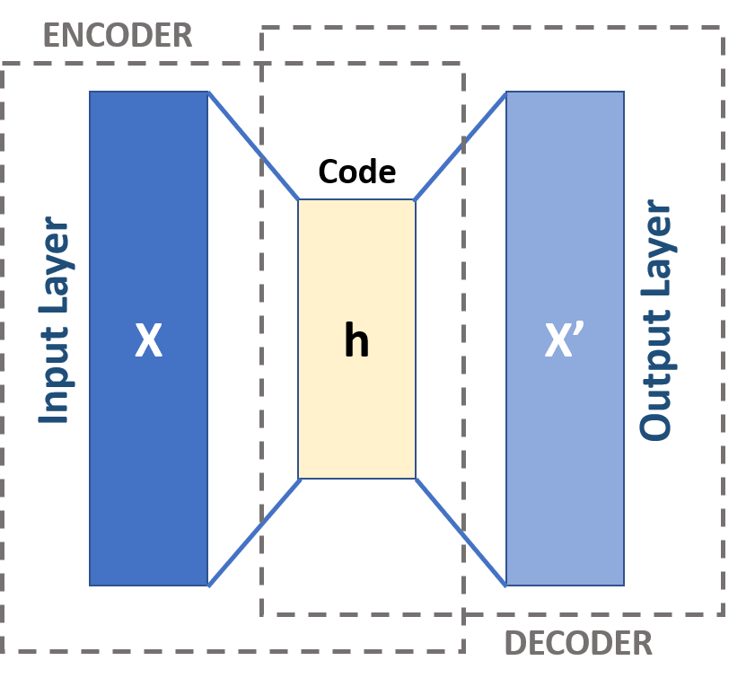
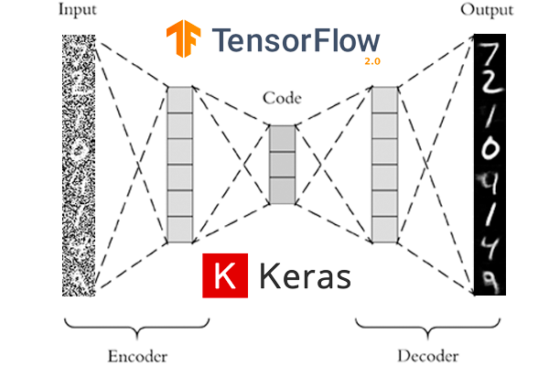
Classical Autoencoder
An autoencoder is a type of artificial neural network used to learn efficient data codings in an unsupervised manner. The aim of an autoencoder is to learn a representation (encoding) for a set of data, typically for dimensionality reduction, by training the network to ignore signal “noise”.

Slide 3
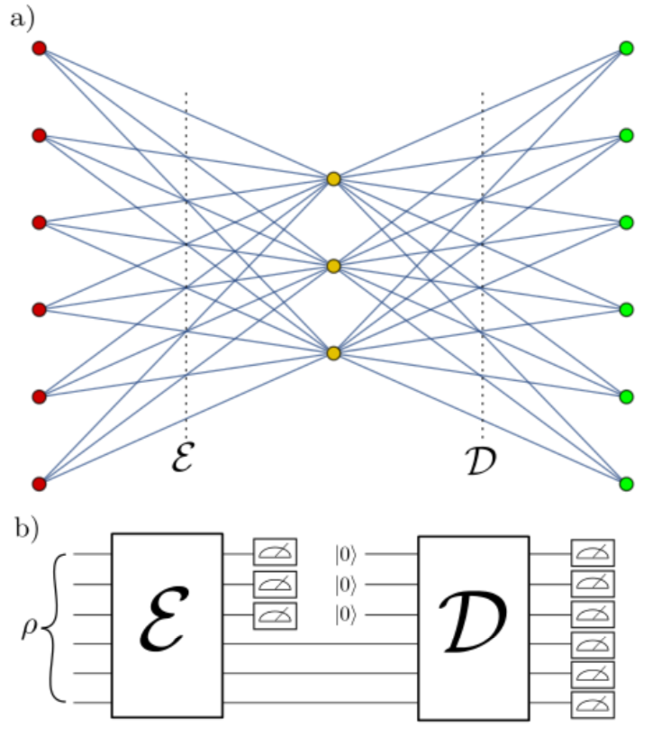
Quantum Autoencoder
Input Data: Quantum state
Motivation: Performing analogous machine learning tasks for quantum systems without exponentially costly classical memory, for instance, in dimension reduction of quantum data.
Application: Quantum memory, Denoising quantum data
(Romero et al., 2017) arXiv: 1612.02806

Slide 4
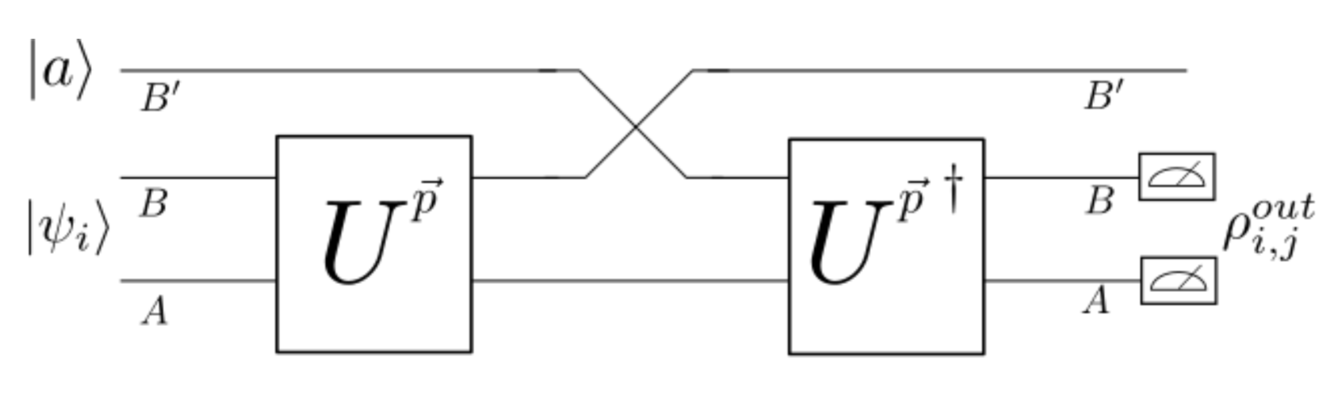
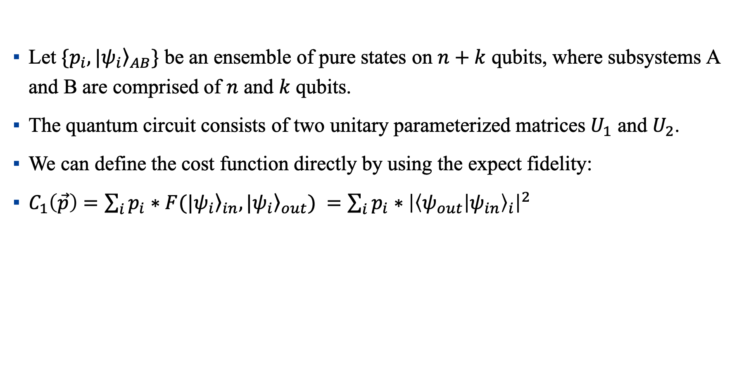
Quantum Autoencoder Model
Let $\{p_{i}, |{\left.ψ_{i}\right\rangle }_{AB}\}$ be an ensemble of pure states on $n+k$ qubits, where subsystems A and B are comprised of $n$ and $k$ qubits.
The quantum circuit consists of two unitary parameterized matrices $U_{1}$ and $U_{2}$.
We can define the cost function directly by using the expect fidelity:
$C_{1}\left(\vec{p}\right)=\sum_{i}{p_{i}∗F(|{\left.ψ_{i}\right\rangle }_{in},{\left.{|ψ}_{i}\right\rangle }_{out}) }=\sum_{i}{p_{i}}∗{\left|{\left\langle ψ_{out} | ψ_{in}\right\rangle }_{i}\right|}^{2}$
1
2

Slide 5
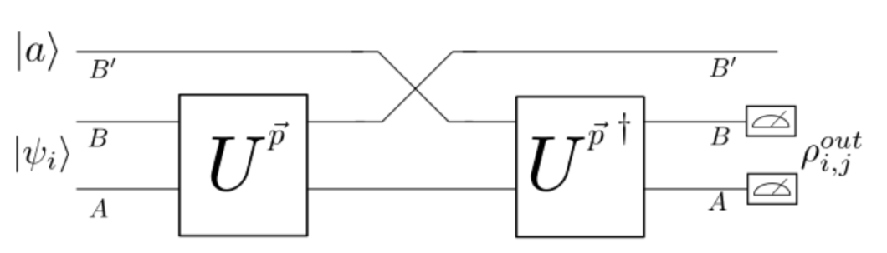
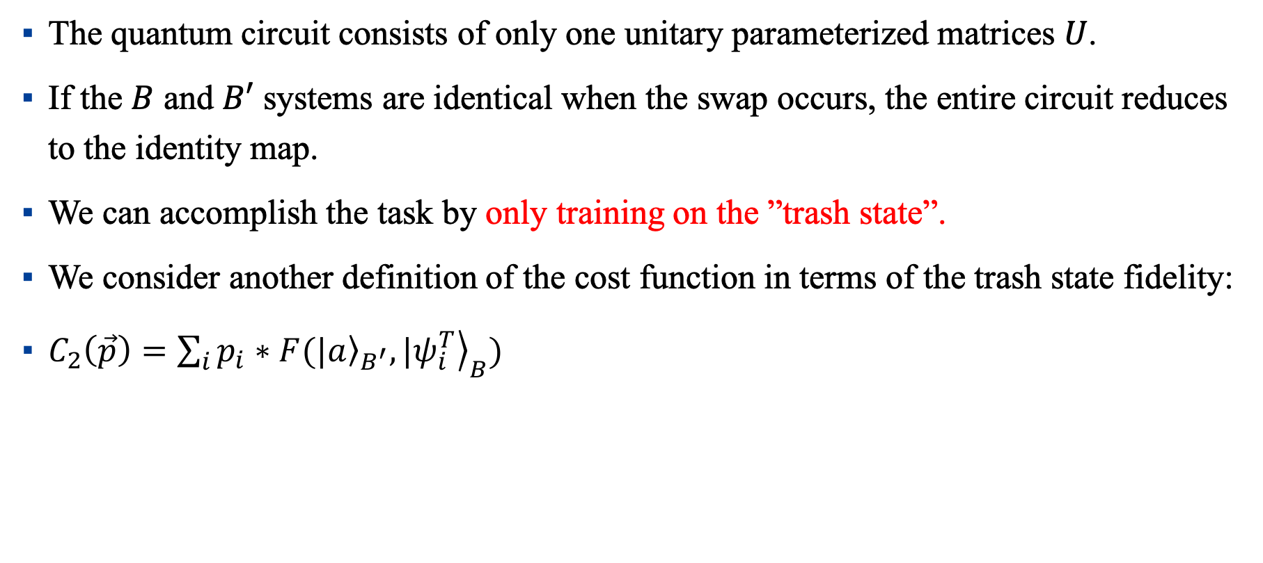
Quantum Autoencoder Model
The quantum circuit consists of only one unitary parameterized matrices $U$.
If the $B$ and $B′$ systems are identical when the swap occurs, the entire circuit reduces to the identity map.
We can accomplish the task by only training on the ”trash state”.
We consider another definition of the cost function in terms of the trash state fidelity:
$C_{2}\left(\vec{p}\right)=\sum_{i}{p_{i}∗F(|{\left.a\right\rangle }_{B^{′}},{|\left.ψ_{i}^{T}\right\rangle }_{B}) }$

Slide 6
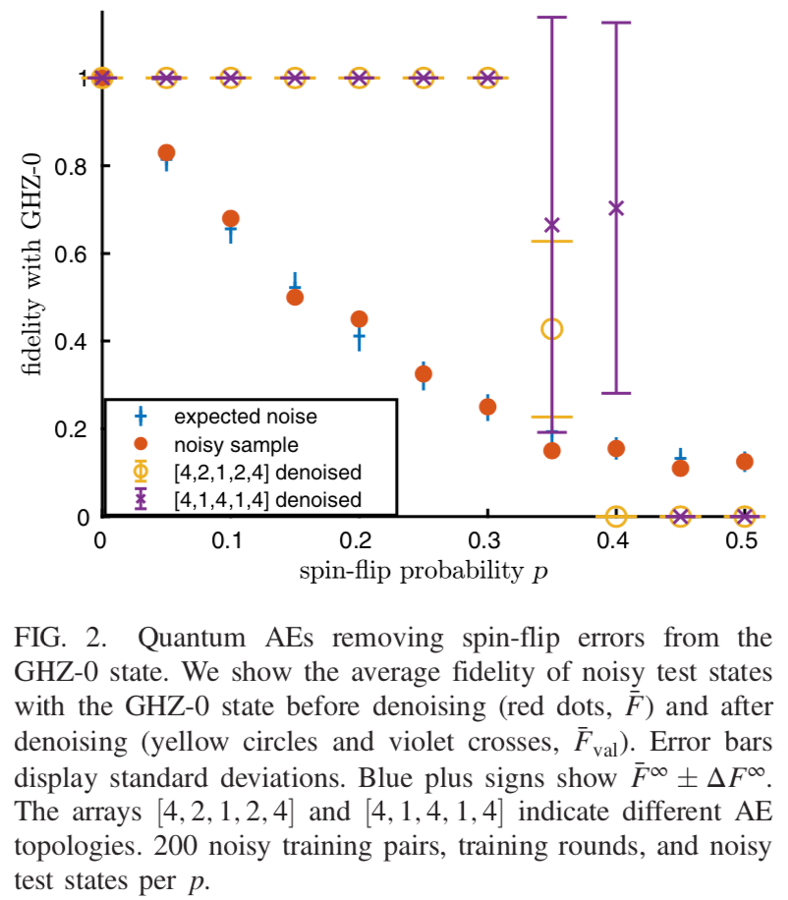
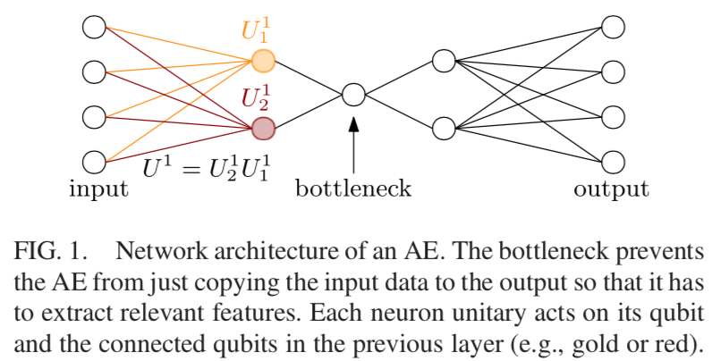
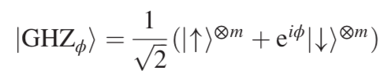
Denoising Quantum Data
(Bondarenko & Feldmann, 2020)

Slide 7
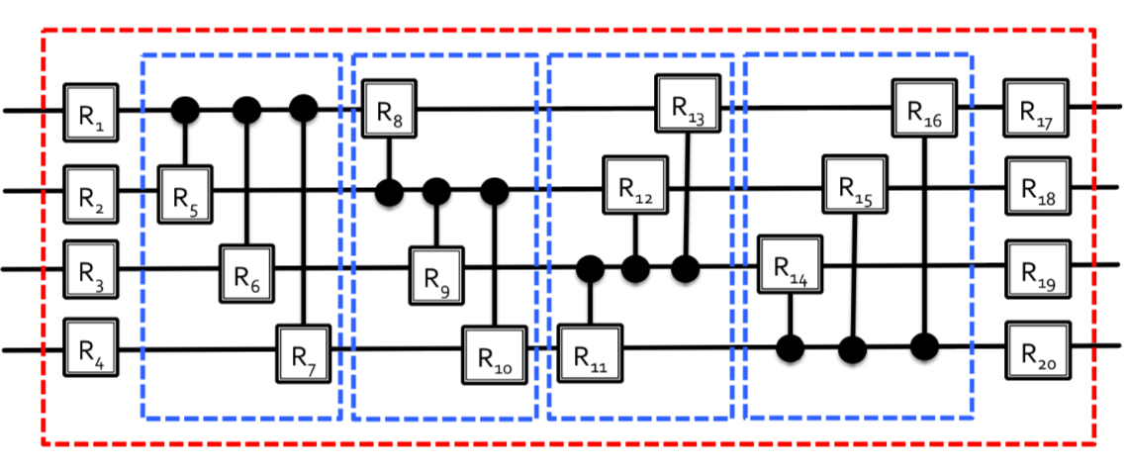
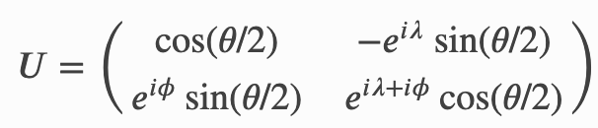


Generation of Arbitrary Multi-qubit Gate
The number of the gates: $n(n+1)$
The number of the parameters: $3n(n+1)$
(Romero et al., 2017) arXiv: 1612.02806

Slide 8
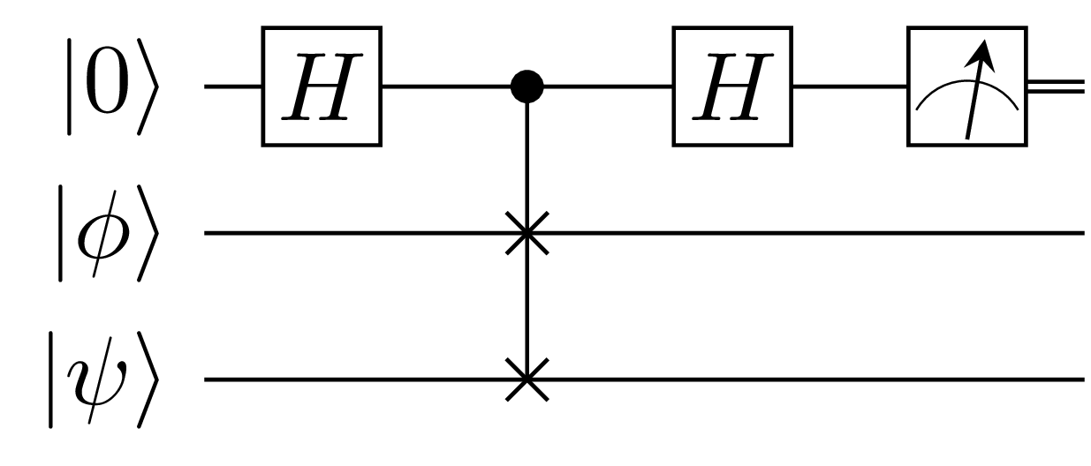


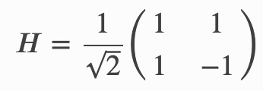
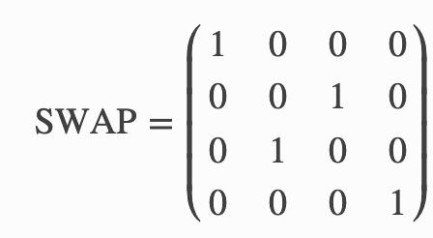
Swap Test
After the Hadamard gate, the state of the system is
The controlled SWAP gate transforms the state into
The second Hadamard gate results in
The Measurement gate on the first qubit ensures that it's 0 with a probability of

Slide 9
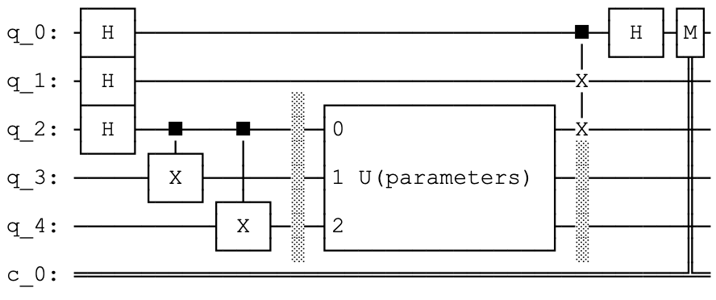
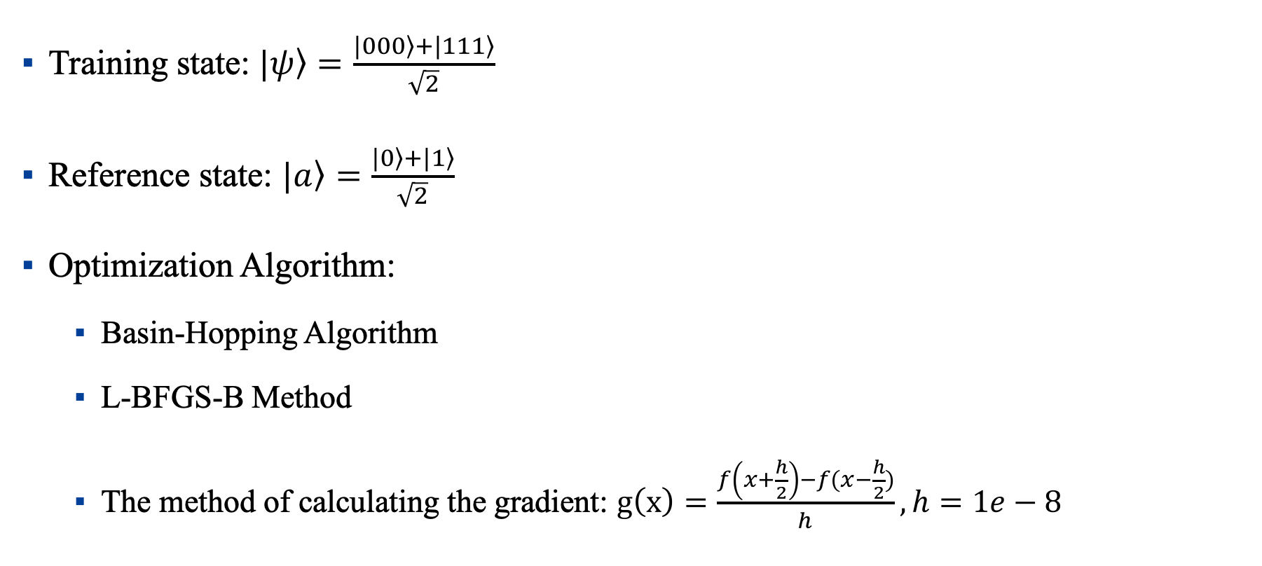
Simulation on the Qiskit of IBM
Training state: $|\left.ψ\right\rangle =\frac{|\left.000\right\rangle +|\left.111\right\rangle }{\sqrt{2}}$
Reference state: $|\left.a\right\rangle =\frac{|\left.0\right\rangle +|\left.1\right\rangle }{\sqrt{2}}$
Optimization Algorithm:
Basin-Hopping Algorithm
L-BFGS-B Method
The method of calculating the gradient: $g\left(x\right)=\frac{f\left(x+\frac{h}{2}\right)−f(x−\frac{h}{2})}{h}, h=1e−8$

Slide 10
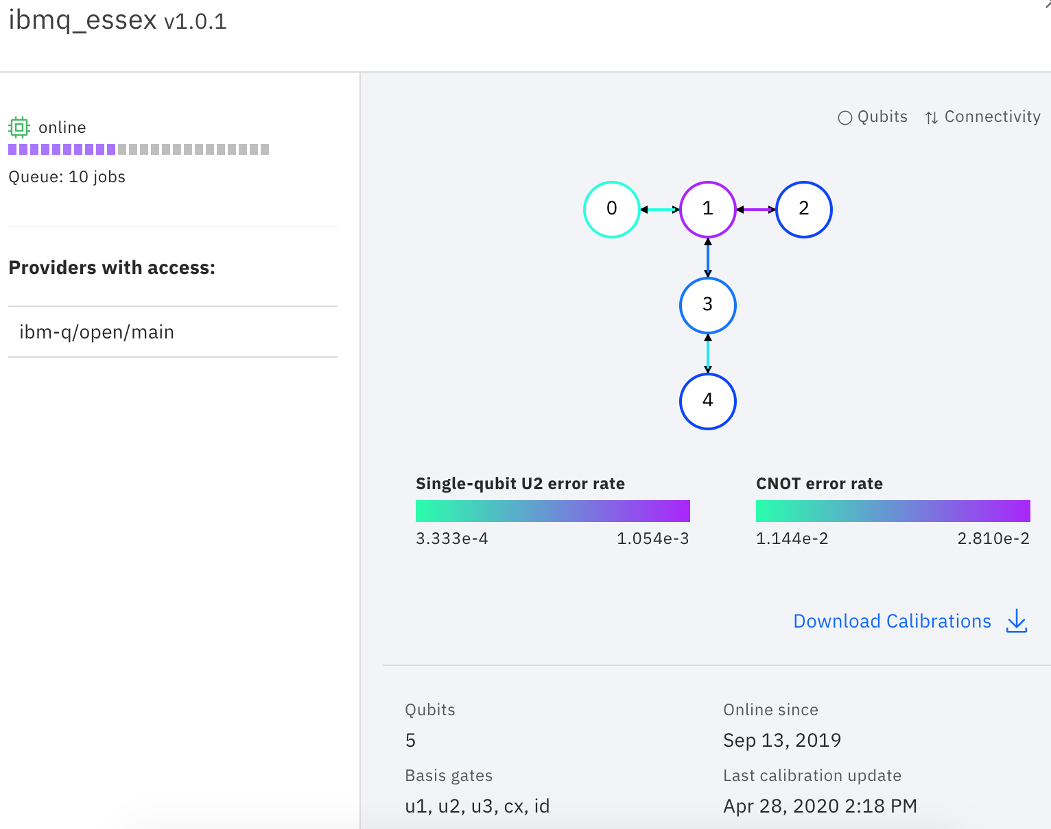
Simulation on Quantum Computer

Slide 11
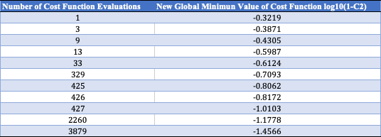
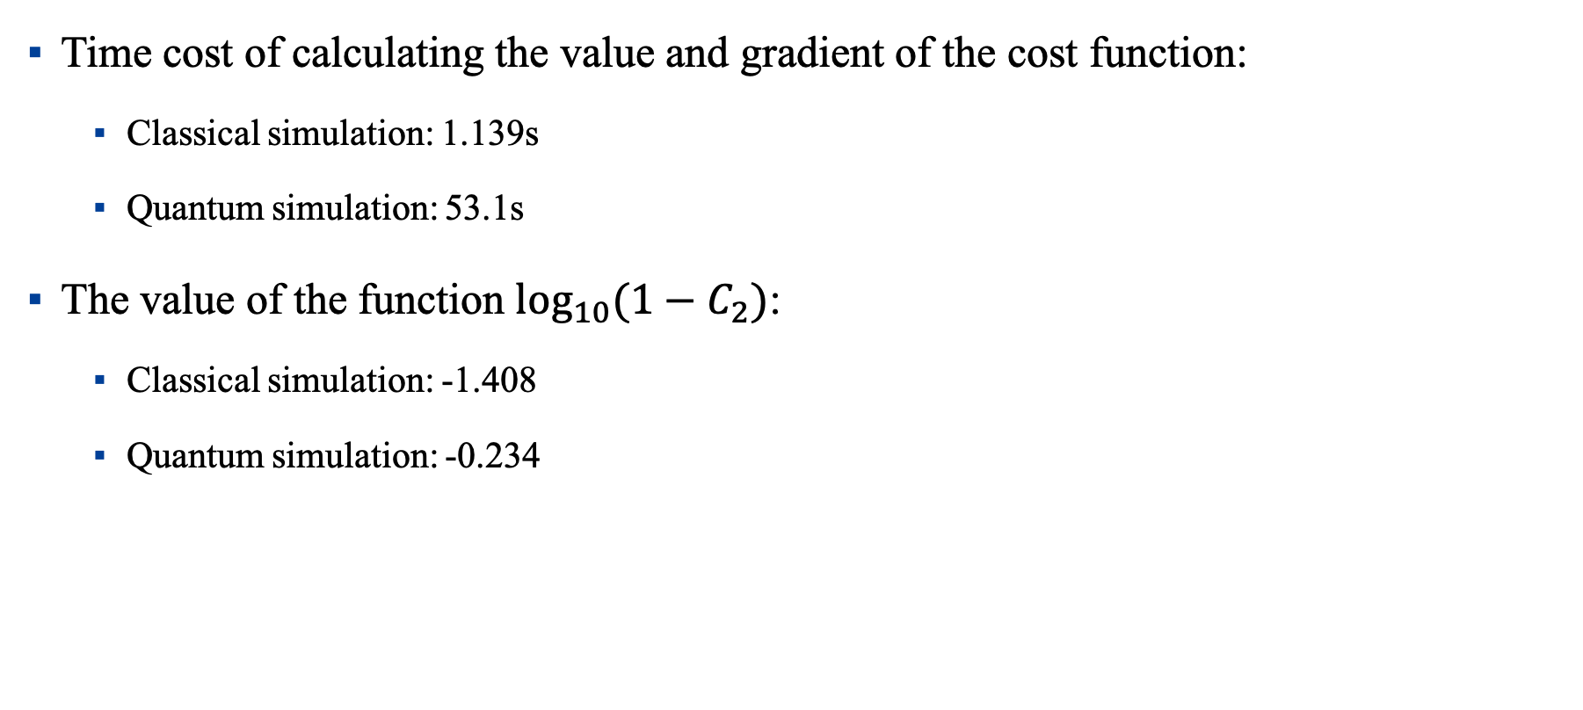
Results of the Simulation
Time cost of calculating the value and gradient of the cost function:
Classical simulation: 1.139s
Quantum simulation: 53.1s
The value of the function $\log_{10}{(1−C_{2})}$:
Classical simulation: -1.408
Quantum simulation: -0.234

Slide 12
Difficulties
The step of assigning the parameters based on Qiskit in the quantum circuit costs too much time, which makes the calculation and optimization of the cost function too slow.
There are too many parameters (324) in [4, 2, 1, 2, 4] quantum denoising NN, which makes it hard to optimize the cost function of the system.
There is too much noise in simulating on a real quantum computer.

Slide 13
Plan for the next stage
Reproducing the work of denoising quantum data.
Doing the noise and robustness analysis of the system.
Writing up the paper of my bachelor thesis.
I want to try something new, but I lack a new idea.

Slide 14

Q & A

